Slide 1
FareShare is the UK’s largest charity fighting hunger and food waste. We redistribute surplus food to frontline charities and community groups that support vulnerable people.

Slide 2
FareShare Sussex is one of 21 regional centres.
We redistribute surplus food to frontline charities and community groups that support vulnerable people.

Slide 3
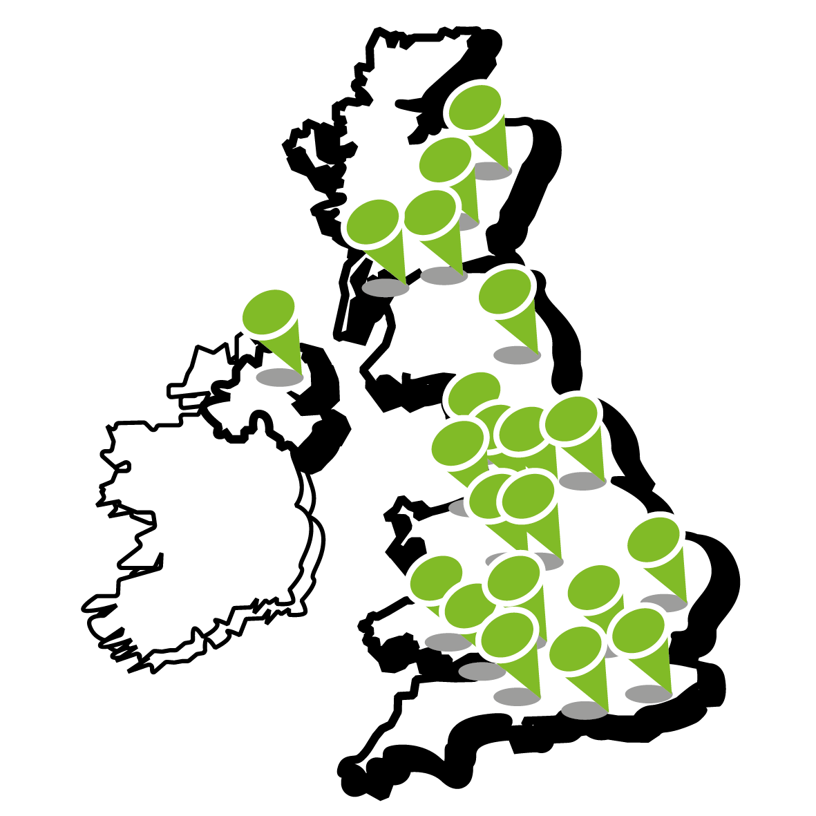
Our locations
Notes:
FS surplus food

Slide 4
The scale of food waste
1,900,000 tonnes
At least 250,000 tonnes of fit for consumption food is wasted by the UK food industry every year*
That’s the equivalent of 650 million meals
* Surplus food redistribution in the UK 2015-2017, 2018 WRAP

Slide 5
FareShare Sussex puts food waste together with hungry people

Slide 6
8.4 million people in the UK struggle to afford a meal
Food & Agriculture Organisation of the United Nations

Slide 7
40 Food Banks
20 Community/Day/Training Centres
20 Supported Housing
10 Children’s and Family Centres
11 Community Cafes
7 Hospice, Carehome or Medical Facility
7 School Breakfast or After School Clubs
8 Drop In Service or Advice Centres
5 Hostels
3 Lunch Clubs
2 Out Of School or Youth Centres
4 Places of Worship
6 Refuges
4 Residential Rehabilitation Services
4 Community Fridges
5 Soup Kitchens
5 Community Food Hubs
Notes:
FS surplus food

Slide 8
How FareShare Sussex works
FareShare redistributes surplus
food from the food industry…
…with the help of an army of volunteers…
…which turn it into nutritious meals…
…to frontline charities and community groups…
Figures 2017 – Registered charity/number 1100051
…for vulnerable people every week…
…last year we provided enough food for 3.6 million meals.

Slide 9
Redistributing surplus food
https://www.youtube.com/watch?v=-ImYNhdp61I&t=22s

Slide 10
FareShare Sussex Impact 2020-21
1560
tonnes of food delivered
21,570
people supported every week
We provide food for 161 charities and community groups every week
10,000 meals every day provided to vulnerable people
We work across 13 local authority areas in Sussex & Surrey

Slide 11
Supermarket surplus = 1%
Supply chain surplus = 49%
In a year, that’s 1 meal for every Ticket-Holder in Elland Road’s East Stand

Slide 12
Who we work with

Slide 13
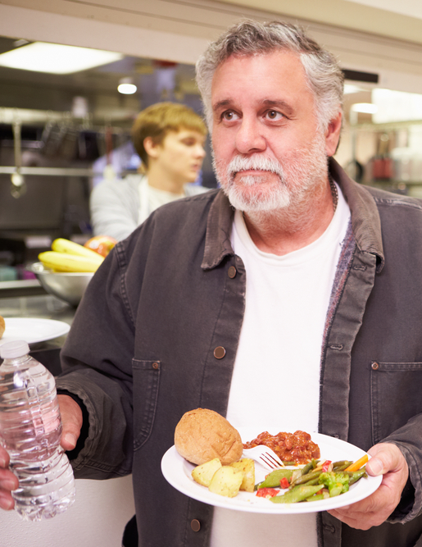
“Financially we would not be able to feed this many people without FareShare. We would not be able to put on hot food like this every day… and this frees up our resources to focus on getting people into accommodation and employment.”
Cath Gilliver,
Chief Executive of SIFA Fireside, homelessness charity
Notes:
SIFA Fireside is a Birmingham-based charity that provides 60 breakfasts and 120 lunches and dinner each weekday for people who are homeless or vulnerably housed.

Slide 14
@FareShareSussex
@FareShareSussex
FareShare Sussex
www.faresharesussex.org.uk

