Slide 1
Foodstrategy
17 march 2021 - VVSG
Frank Bakkum
Dep. Urban planning & Sustainability

Slide 2
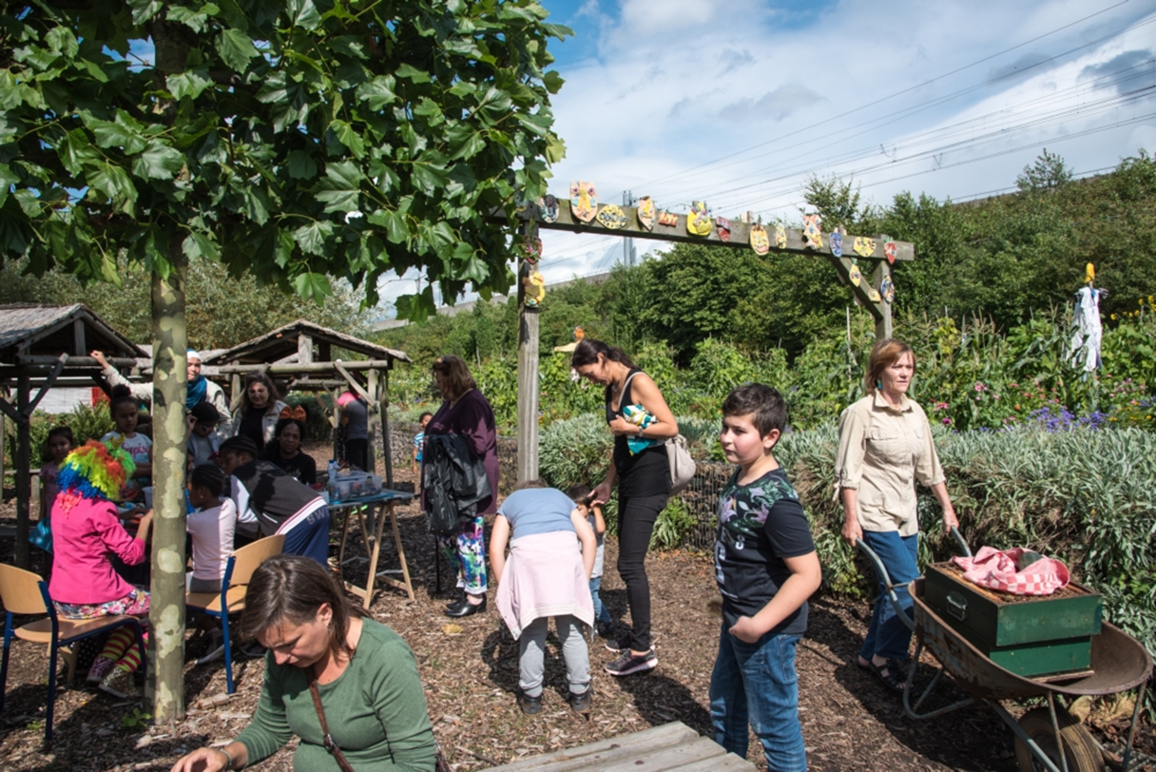
Identity – green city

Slide 3
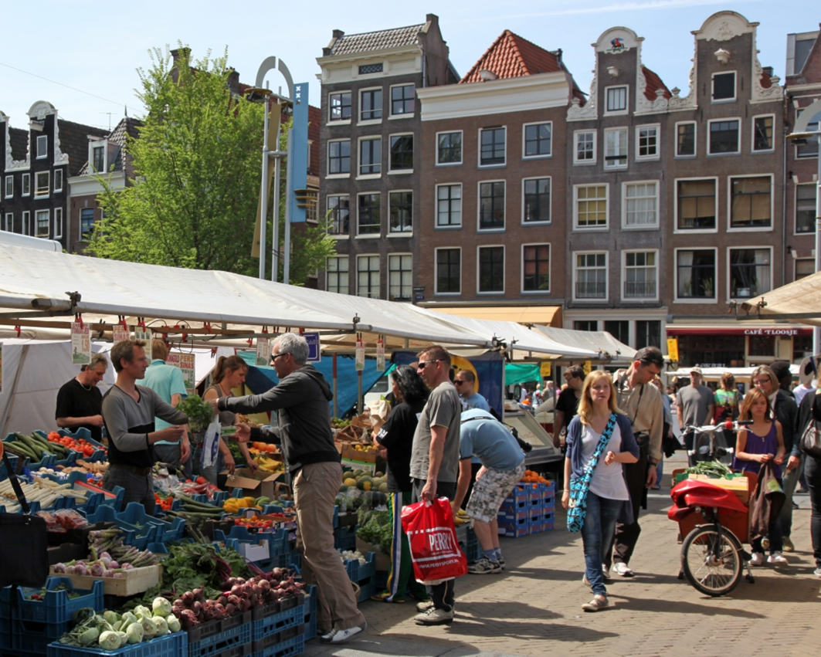
Culture

Slide 4
Region and landscape

Slide 5
Cooperation

Slide 6
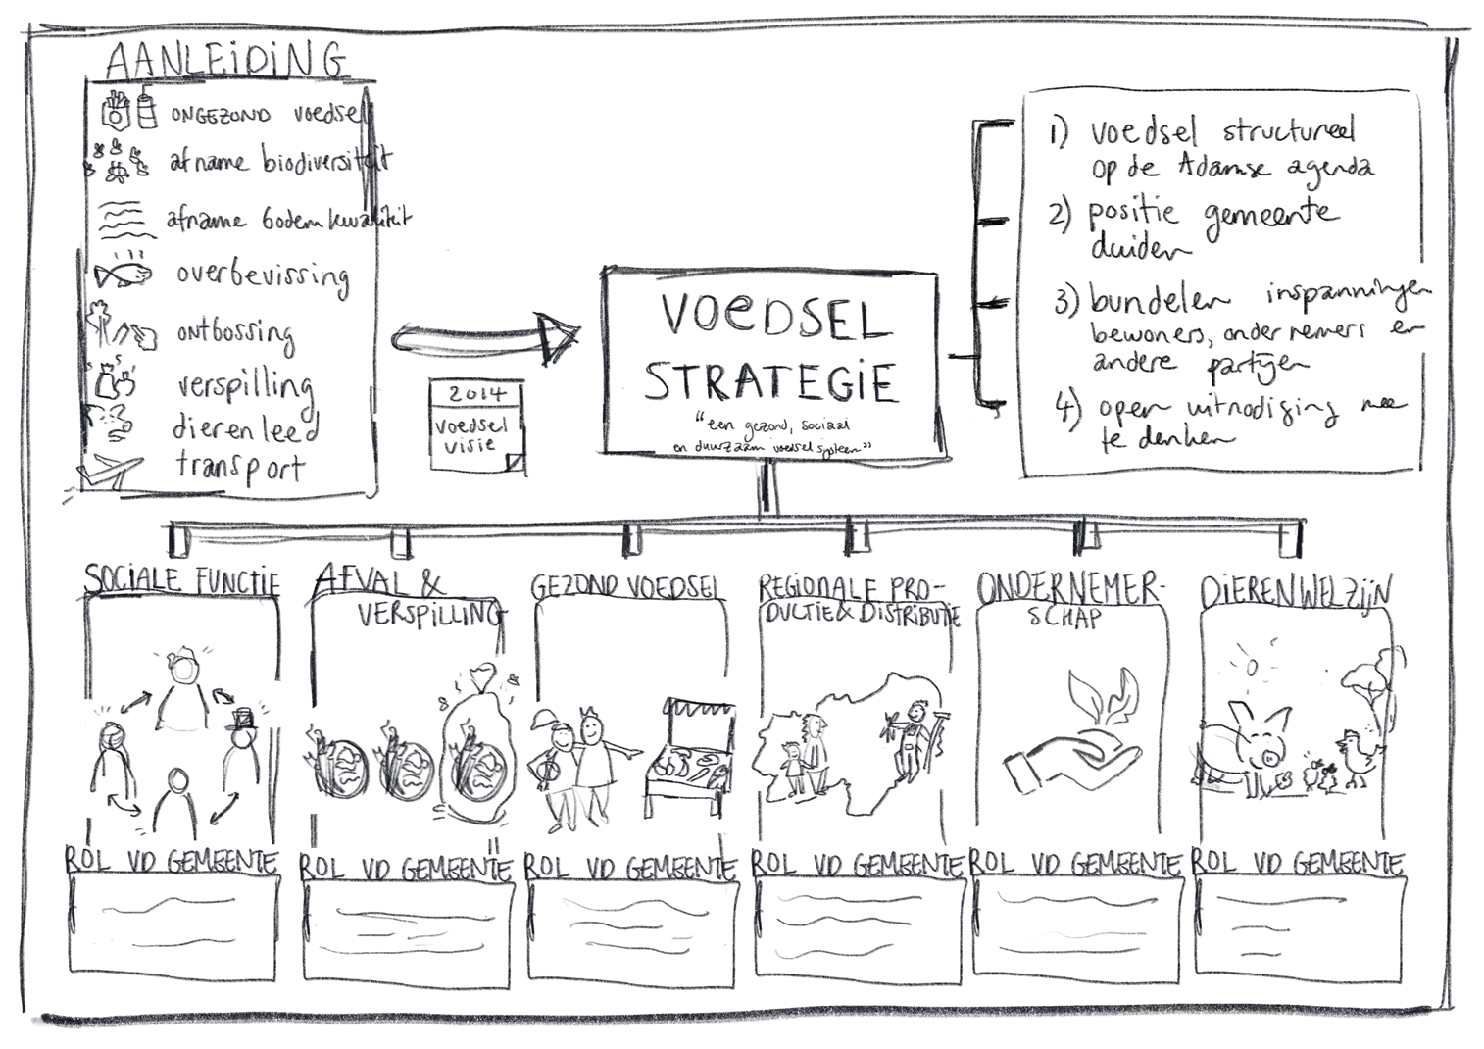
Work in progress

