Slide 1
Quito’s agrifood policy journey
VVSG Learning Network on Food Policies, 17 March 2021

Slide 2
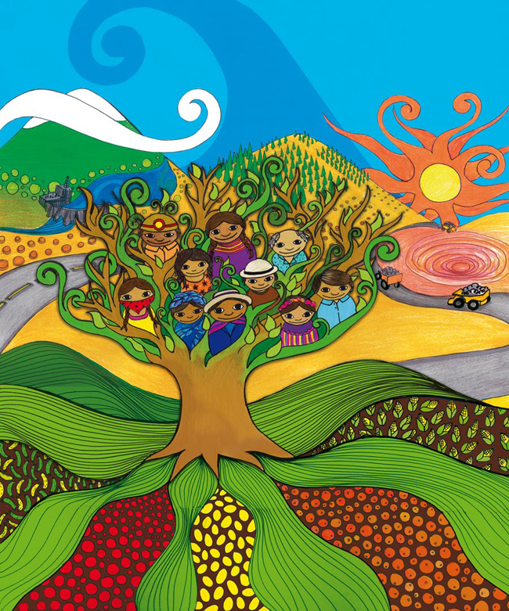
Quito’s food journey
Disclaimer
Rikolto is not representing the city of Quito. However, we are happy to share experiences from our collective journey from the past 5 years as a member of the secretariat of the multi-stakeholder group “Pacto Agroalimentario de Quíto”.
This presentation builds on input from:
Alexandra Rodríguez: AGRUPAR Project Manager, Quito
David Jácome-Polit: Chief Resilience Officer, Quito
Nataly Pinto: Food Smart Cities Coordinator for Latin America (based in Quito), Rikolto

Slide 3
In Quito…
Unemployment: 7.10%
Underemployment: 11.30%
Poverty: 12.8%
Extreme poverty: 4.6%
Migration / refugees:
240,126 Venezuelan migrants (2019)
60,329 Colombian refugees (2016)
Population:
2.5 million
Fruit & veg consumption:
183g/day (WHO recommendation: 400g/day)
Overweight and obesity: 63%
Chronic child malnutrition: 29%
Undernourishment: 7.8%
Natural events:
Volcanic eruptions, seismic activities, landslides, climate change

Slide 4
Quito’s Food journey
- Launch of AGRUPAR – urban agriculture project
- Integration in Conquito (economic development, health & economic development)
- Quito Food System Assessment – CRFS pilot city (FAO & RUAF) - HABITAT III - Join MUFPP, RUAF, Rikolto FSC programme, C40 sustainable food systems boards
- Launch of PAQ MSH platform - Core group for food policy - Signature of the Quito Food Charter
- Quito Agrifood Strategy - Vulnerability / Food resilience strategy - Pilot city for MUFPP indicators
- Project on food hubs with Lima, RUAF and Rikolto
2002
2015 - 2017
2019
2005 -2015
2017-2018
2021

Slide 5
The PAQ - Multistakeholder platform
Local, provincial and national authorities
Civil society
Private sector
International cooperation
Academia
50+
People and institutions
57
meetings

Slide 6
Vision of the food strategy
Quito is a territory that promotes a sustainable and resilient Agri-Food System, from environmentally friendly production and transformation, through distribution with eco-efficient logistics and fair and inclusive marketing, to waste management and responsible consumption that empowers citizen participation.

Slide 7
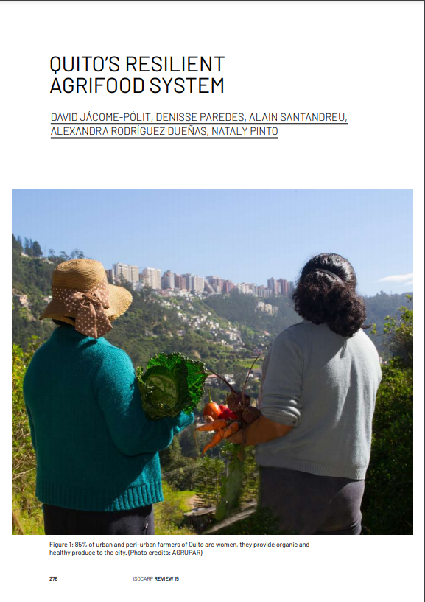
2 strategies
2018
Agrifood strategy
2019
Agrifood resilience
Strategy + vulnerability assessment
Notes:
5 key priority areas in the Agrifood strategy:
Managing food resources for the future (sustainable production)
Governance (PAQ, charter, alliances)
Food sovereignty, security and nutrition (engaging citizens, CSOs, preventive actions to support the most vulnerable)
Inclusive food economy & strengthening rural-urban linkages (inclusion of smallholders, boosting responsible SMEs, inclusive marketing, food hubs & logistics)
Management of organic / food waste (circular economy principles, reduction of food waste at all stages & reduce plastic us
For each pillar, there’s 1) a diagnostic, 2) definition of problems per area, 3) strategic guidelines, 4) indicators and 5) an action plan
1. Managing Food Resources for the Future:
Create strategies and incentives to enable the adoption of sustainable production and processing practices.
Promote regulations with costs and incentives for actions that deplete or degrade natural resources.
Develop instruments to assess, mitigate and manage natural hazards.
2. Governance:
City pact to promote healthy eating - Food Charter.
Quito Agri-Food Council, Resolution of the Mayor's Office.
Alliances at provincial, national and international level in the areas of food, environment and production.
3. Food security, nutrition and food sovereignty
Define preventive actions in the face of the current epidemiological situation in Quito-Region, with emphasis on the most vulnerable population.
Include communication campaigns and workshops with holistic information about the food that is sold as part of a culture of responsible consumption.
Encourage the formation of networks and support civil society initiatives related to healthy eating.
4. An inclusive food economy and rural-urban linkages
Establish inclusive networks and alliances of responsible entrepreneurs and the inclusion of small and medium-sized local producers.
Promote sustainable and inclusive marketing systems that source food from smallholders in private and public points of sale, Fair Trade shops and public procurement.
Develop logistics platforms, such as collection, processing and control centres for perishable products entering the city in coordination with the public and private sector.
5. Management of organic waste:
Establish technical and operational strategies for the management of organic waste and/or residues (generation, storage, collection, transport, use, treatment and final disposal).
Promote the circular economy through organic waste management with emphasis on the inclusion of vulnerable groups.
Address the issue of reducing the use of plastics related to packaging, food containers and packaging and single-use plastics.

Slide 8
Coming to the rescue in times of covid…
Listen to David in our webinar here

Slide 9
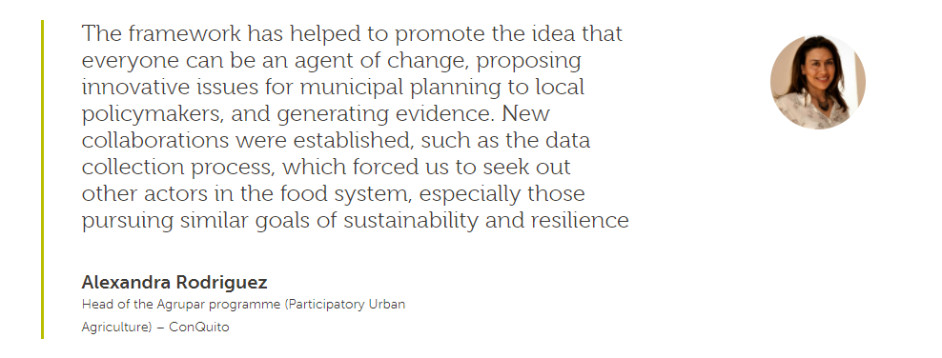
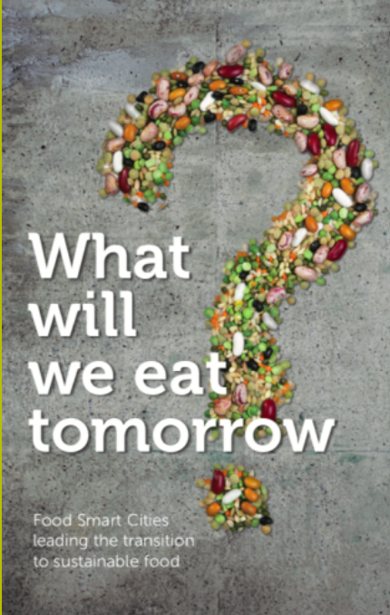
Lessons learned
A city-wide systemic process can emerge from an initially small-scale project focused on urban agriculture and agroecology.
To engage conventional farmers in the process, it’s necessary to put in place support systems that are relevant and of added value to them, hence the need to involve them in policy discussions around the food strategy.
A food systems assessment which maps food flows is essential to understand how to better balance local and international food chains in the best way and navigate trade-offs.
Political commitment is key. Engaging elected officials should be part and parcel of every food strategy process.
On the importance of data and monitoring results (in relation to the MUFPP indicator framework):
Get a soft copy of the book here

Slide 10
A call to action

Slide 11
The Glasgow Food & Climate Declaration
What?
A commitment to tackle the climate emergency with a food systems approach and a call to national governments to create enabling environments for local policy initiatives.
Bring a unified voice to the climate negotiations in Glasgow on the need for a food systems approach to climate change action.
Why?
Food systems account for 21-37% of global GHG emissions and must be addressed to achieve the goals of the Paris Agreement;
International (and national) climate change policies fail to consider food systems holistically, resulting sometimes in inconsistent policies.
For whom and by whom?
Inclusive of all sizes of subnational governments: from towns to large cities, regions, rural municipalities, and provinces.
Drafted by a coalition of 40+ subnational government networks, NGOs, think tanks and city and regional governments

Slide 13
How to sign?
Subnational, regional, local and national governments across the world are invited to join the call for a food systems approach to climate action by signing up to the Glasgow Food and Climate Declaration at:
https://www.glasgowdeclaration.org/how-to-sign
The signature process:
Submit the form on the ‘how to sign’ page
The secretariat run by IPES-Food and Nourish Scotland will contact governments to confirm their commitment
Current signatories (31): Quito, Bruges, Leuven, Ghent, Milan, Paris, Vancouver,, Bristol, Barcelona, Scotland, Antananarivo, Istanbul, Philadelphia, Solo, Douala, Glasgow, Valencia, Bobo-Dioulasso…

Slide 14
Rikolto
Blijde inkomststraat 50
3000 Leuven
+32/16 31 65 80
Charlotte Flechet
Charlotte.flechet@rikolto.org
www.rikolto.org
Twitter - Instagram: @rikolto
Linkedin.com/company/rikolto

