Slide 1
Brighton & Hove Food Partnership
Vic Borrill, Director
Vic@bhfood.org.uk
@btnkitchen @btnhovefood

Slide 2
Brighton & Hove small city on south coast of England….. population 290,000 and rising. Prior to Covid 8 million tourists a year

Slide 3
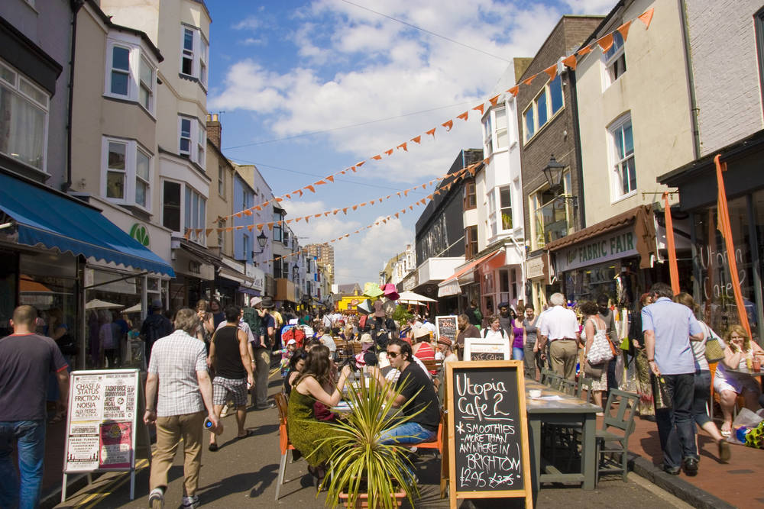
A city of contrasts
Compact city – sea on one side South Downs National Park on the other.
The city council owns 4,400 hectares of farmland. Very little of this is used to produce food for the city.
Most restaurants per capita in UK
1 in 5 jobs linked to hospitality / tourism
Caterers eg schools and universities serve over 1 million meals per month
Strong community – 50%+ population volunteers
UK’s only Green Party MP
4th most unequal city in UK according to Centre for Cities
Young city, 2 universities but higher than average levels of youth unemployment
….. These stats are all pre-Covid

Slide 4
Why take a food approach?
Food often seen as a problem eg obesity, waste, pollution.
It is also a solution if used as an approach to achieving good health, wellbeing, connected communities, reuse and sustainable economy
People ‘get’ food – we all eat
One behavior change around food often leads to another
Food is an essential ingredient in meeting climate change targets

Slide 5
Brighton & Hove Food Partnership a hub for information, inspiration and connection around food.
Independent, not for profit, politically neutral organisation
Work with individuals eg teaching cooking or in community gardens
Work with volunteer led community food groups eg food banks, meal projects and composting
Work with restaurant, retail and caterers
Work at a policy eg planning and procurement
Communications /Public support eg social and e-news
Lead the partnership work bringing together stakeholders in the Food Strategy
Notes:
Activism is quite simply taking action to effect social change;

Slide 6
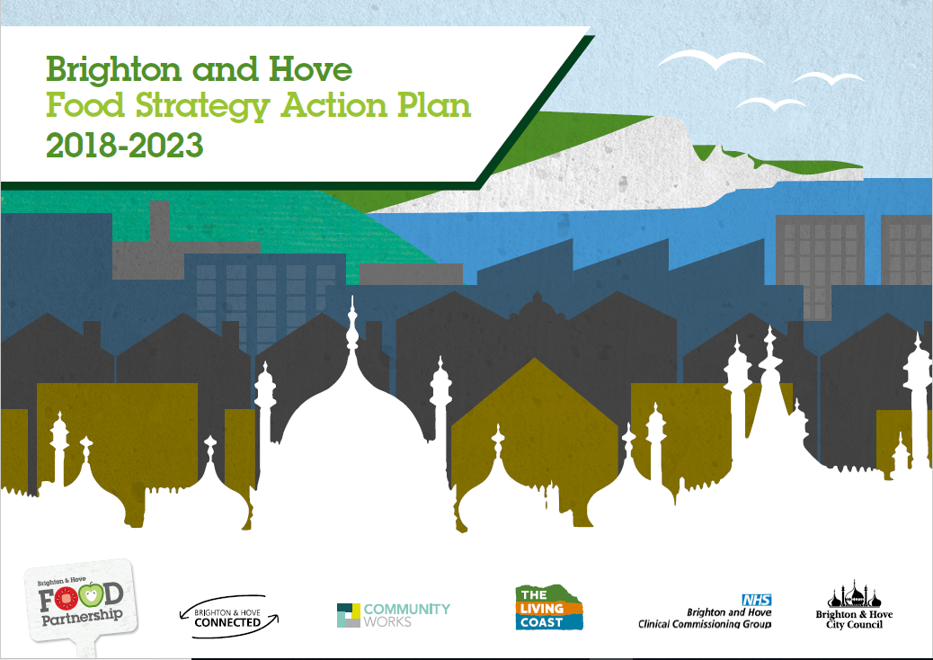
Food Strategy – place based action plan
3rd version first one in 2006
200+ actions and 100 partners working for a healthy, sustainable, fair food system for all. Adopted by City authority
Shared vision and Action plan
Both doers and thinkers – practical and policy
Overseen by expert panel. Because food is a cross cutting issue those involved come from a wide variety of backgrounds
Its all about supporting partnership work around food and looking for cross cutting action
Process of consultation and writing the plan crucial – facilitated events, focus groups, surveys, 1-1 interviews + city data

Slide 7
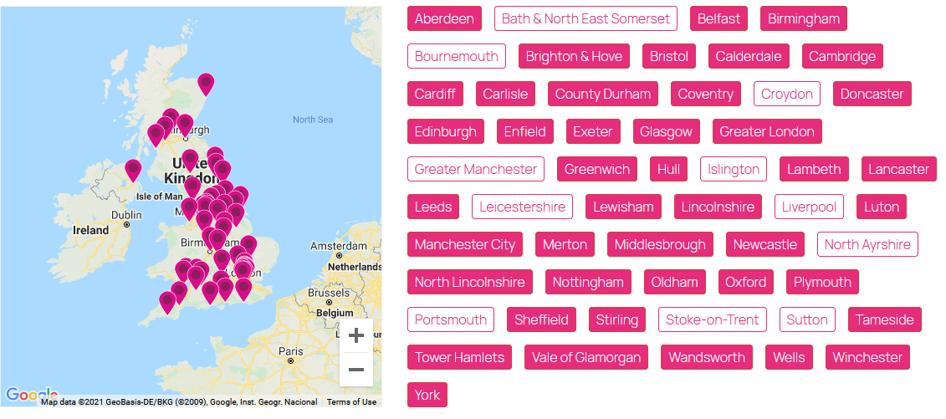
Member of UK network Sustainable Food Places
60 places across the UK taking a place based, cross sector approach to achieving a better food system.
Food Partnerships are housed in different settings eg city authority, health service, not for profit sector
SFP offers support for those at different stages of their Food Partnership journey, runs training and event, provides funding and support. SFP runs an awards scheme

Slide 8
Useful information
www.bhfood.org.uk
@btnhovefood
Food strategy pages https://bhfood.org.uk/resources/food-strategy/
Climate change and food plans
https://bhfood.org.uk/resources/food-and-climate-change/
How we got Gold www.bhfood.org.uk/resources/how-we-got-to-gold/ including a film of our work
Sustainable Food Places – includes toolkits for places interested in setting up Food Partnerships www.sustainablefoodplaces.org

